Slide 1
Stairs
Calculate the minimum size of stairs
Identify the features of stairs

Slide 2
Historic Fire
Grenfell Tower

Slide 3
Stairs are Simple
https://themindcircle.com/30-epic-stair-design-fails/

Slide 4
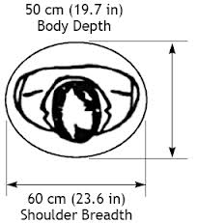
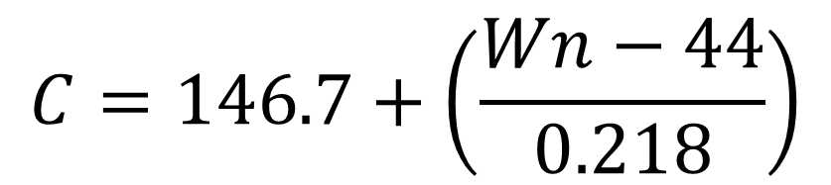
Stair Widths
Exit lanes
  Not used by NFPA101 or IBC
Width calculations
  NFPA
  IBC

Slide 5
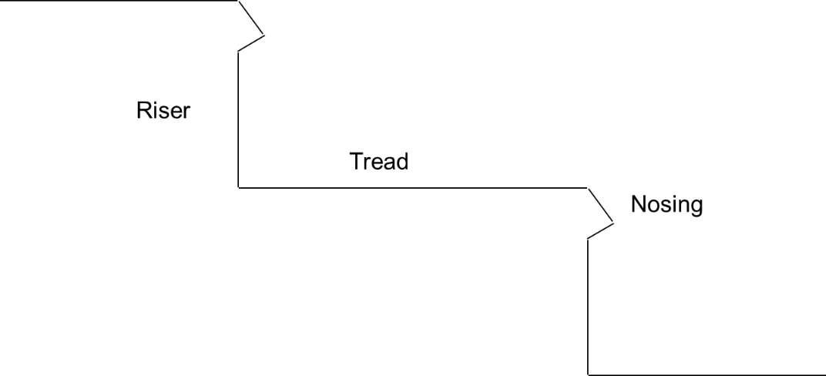
Stairs
Size
Usage
Slip resistant
Marked
Changes in size
  3/16 in
  3/8 in

Slide 6
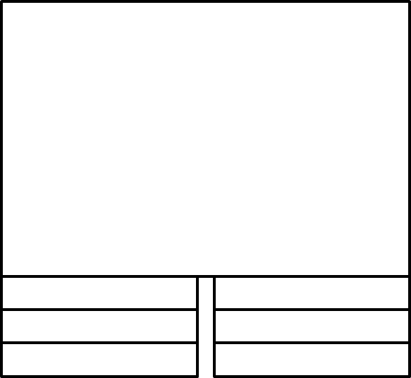
Stair Terminology
Flight
Landing
Dog-leg
  Sinistral
  Dextral
Straight
Curved
Spiral

Slide 7

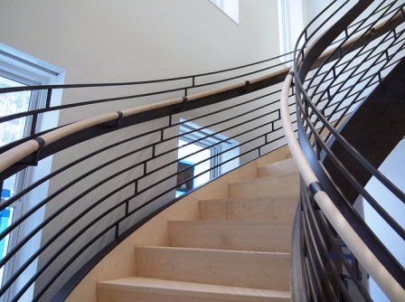
Curved and Spiral Stairs

Slide 8

Handrails and Guards
Shape
Location

Slide 9
Outside Stairs
Account for fear of heights
  ≥ 36 ft
  Opaque ≥ 48 in
Separated from interior
Minimize water accumulation
≥ 50 % open on one side

